Slide 1
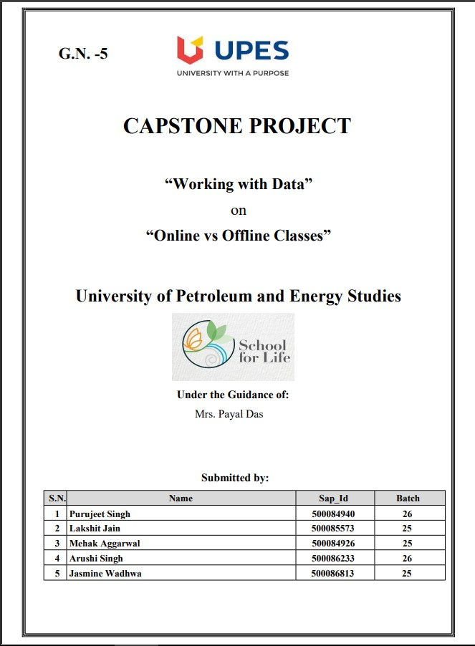

Slide 2



PRESENTATION
ONLINE vs OFFLINE Mode of Learning

Slide 3
CONTENTS
1. Introduction
2. Research Methodology
3. Demographic view of Survey Participants
4. Financial Analysis
5. Effects of Online learning
6. Effects on Examination
7. Employment Issues
8. Conclusion
9. Responses and Questionnaire

Slide 4
INTRODUCTION
This report presents the results of a survey conducted in April-May 2021 to study the participants’ preferences in the mode of learning.
The goal was to have a clear idea about the learners’ perspective on this subject and hence decide which mode of learning would be beneficial in the future. Also, it helped to know about the required changes to be done if we continue with the online mode.
This report summarises the aggregated results of the survey, question by question. For each question, a statistical overview, a graphic representation, and a summary of the "main messages" appearing from the data are given.

Slide 5
Research Methodology
The form consisted of 15 questions that covered subjects such as preferences of the participants; the effect on finances, learning, grades; problems encountered during online interaction, and examination. Employment-related questions are included in the form to ensure that the data is analyzed on all the possible variants to yield accurate results.
We received 1,024 responses from learners belonging to different states and universities, each using distinct platforms for e-learning. This fact helped to ensure that the results aren't derived from the pros and cons of a single digital platform.
The questionnaire form and the responses are attached at the end of this report. All findings presented here refer exclusively to the respondents of the survey

Slide 6
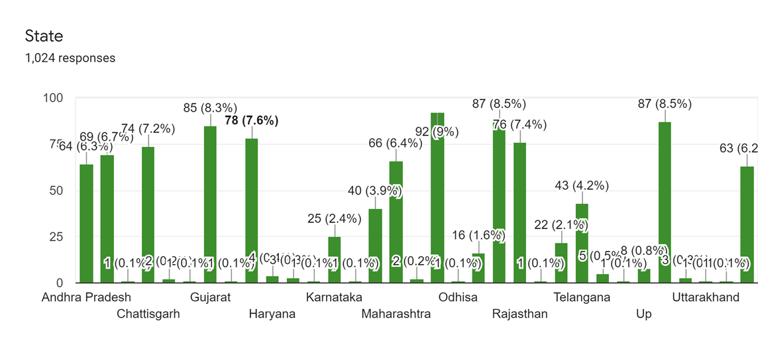
Demographic view of Survey Participants

Slide 7
Here, we have tried to publish a demographic summary of survey respondents in March 2021.A form. A
google form was circulated among students and they were asked to answer the questions given to them in
the form. This summary was based on 1,024 responses. A brief demographic analysis of the 1,024
participants considered in the report revealed that 6.3% reside in Andhra Pradesh and 6.9% in Bihar,7.2%
in Chhatisgarh,8.3% Gujrat,7.6% in Haryana, 2.4% in Karnataka,3.9% in Madhya Pradesh,6.4% in
Maharashtra,9% in New Delhi,1.6% in Odisha and from several other states across India

Slide 8
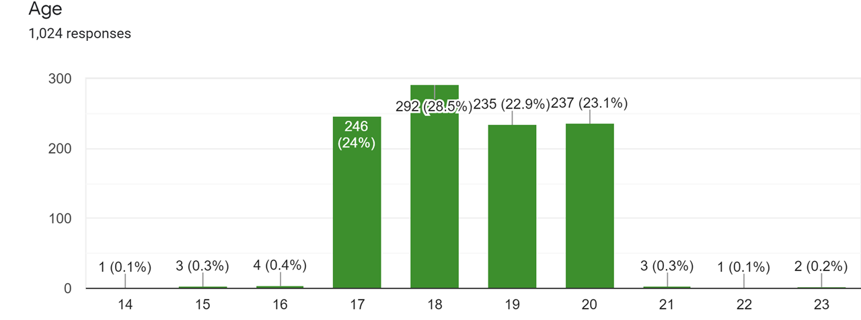
In terms of age: 24% were aged around 17, 28.5 % were found to be of age 18,22.9% were found 19, and 23.1% were found to be 20 years old. These were the age groups the held the majority of the responses from the participants.

Slide 9
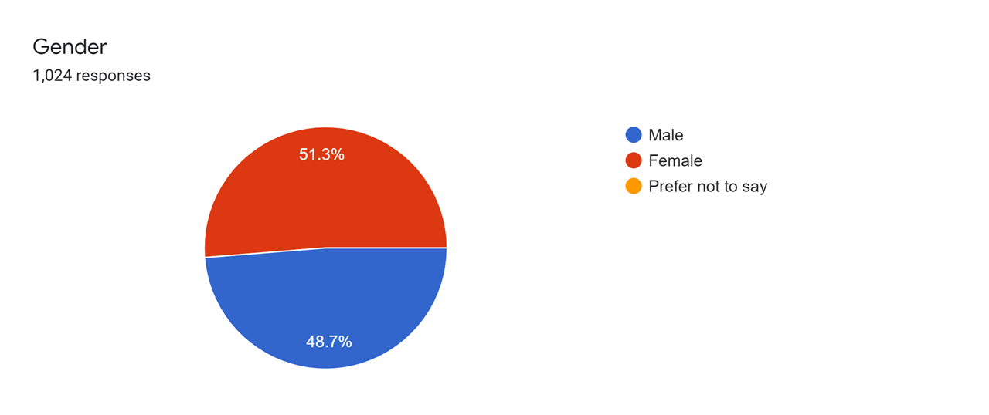
In terms of gender: 51.3% were found to be male participants while 48.7% were found for female participants. According to responses males held more responses than females. Looking at the majority of their educational background of the respondents were pursuing a Bachelor of Technology and were either in their fresher or sophomore year

Slide 10
Online vs offline mode of learning has a large impact on finances be it institutions or parents at the other side of the table.
Parents are not satisfied by the fees they are paying to institutions for other facilities also which students are not getting due to covid situation
During offline classes, parents were having no problem regarding Student academics as they were getting proper guidance in school but in online scenarios other than school fees they also have to arrange proper internet connection and tutor to mentor them.

Slide 11
Main Message: -
Profit for institutions.
Parents and students are highly disappointed due to high fees

Slide 12
Effects of Online learning
Online mode has both advantages and disadvantages. One of the advantages being to adjust to almost everyone’s schedule. Studying or working from home helps people to plan their schedule better cutting off the transport time. Also, it provides us with the recording option so as to review the content later on if at anytime a person isn’t able to fit the classes in their schedule.

Slide 13
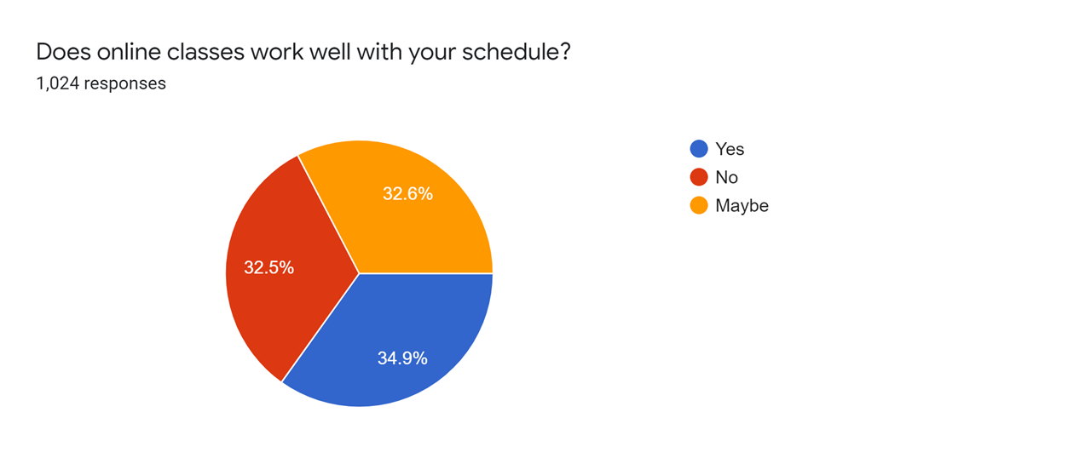

Slide 14
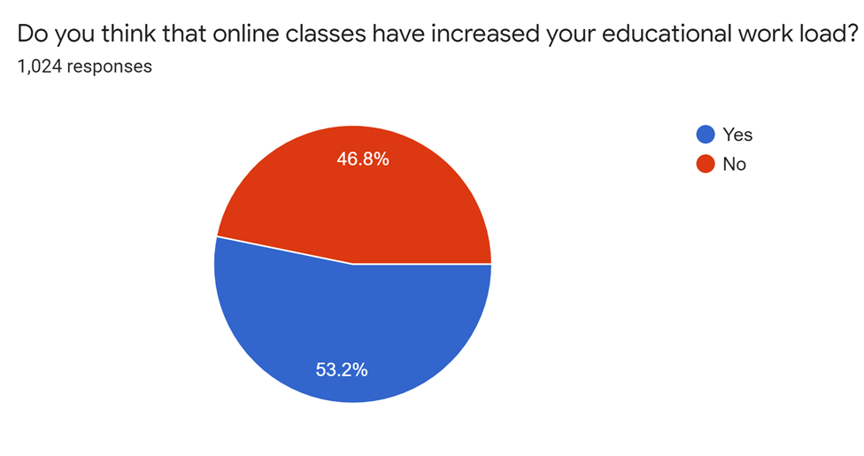

Slide 15
The offline mode used to have fixed hours of lessons, and most of us were adjusted to that but in online mode, the time of lessons varies a lot. The screen-time of learners has increased a lot which adds to stress.

Slide 16
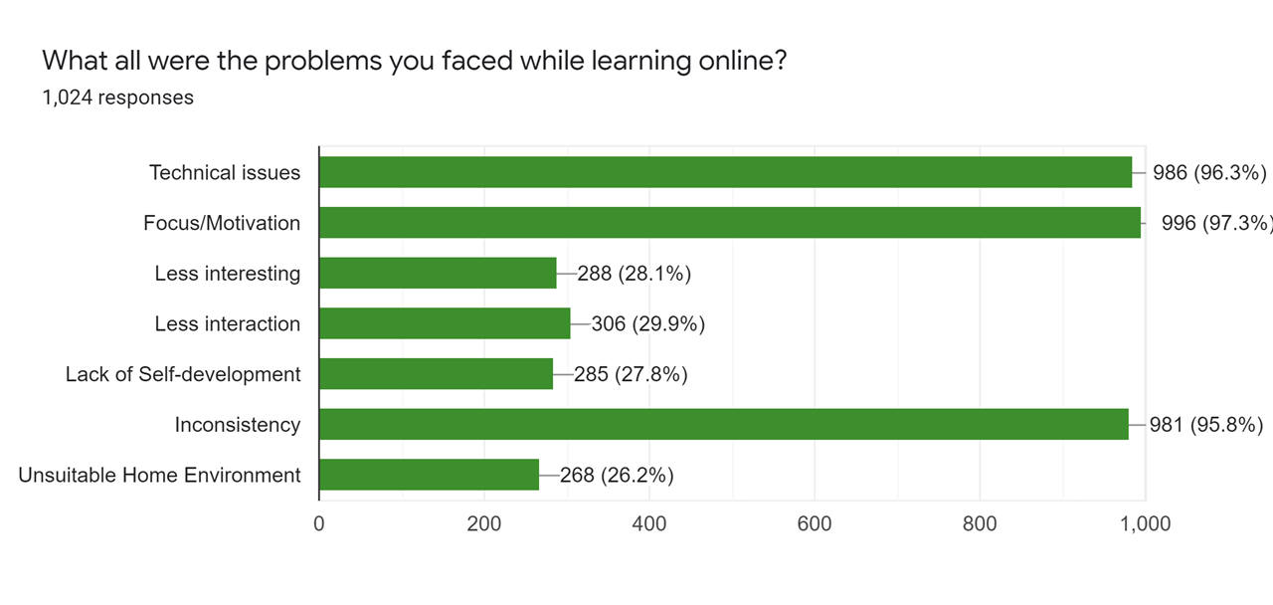

Slide 17
Learners encounter many issues while studying online. Some face technical issues which is by far the most common issue. Studying in a room alone instead of a class filled with familiar faces leads to a lack of motivation/focus due to less interaction with the other learners.
The lack of practical knowledge also makes the subject less interesting. Moreover, some students face issues due to unsuitable home environments as well

Slide 18
Main Message: -
Most of the participants are satisfied with the changes in their schedules.
Educational workload has increased due to change in the mode of learning.
- Learners lack focus and motivation due to the online mode. Also, they face many issues due to technical problems.

Slide 19
Effects on Examination
The project mainly intends to provide the intentionality and functionality and behaviour of the Online examination. Here, we have tried to project how online examinations have affected the academic lives of the students in terms of their grades and their regular academic schedule. And how satisfied do they seem with this new mode of learning?

Slide 20
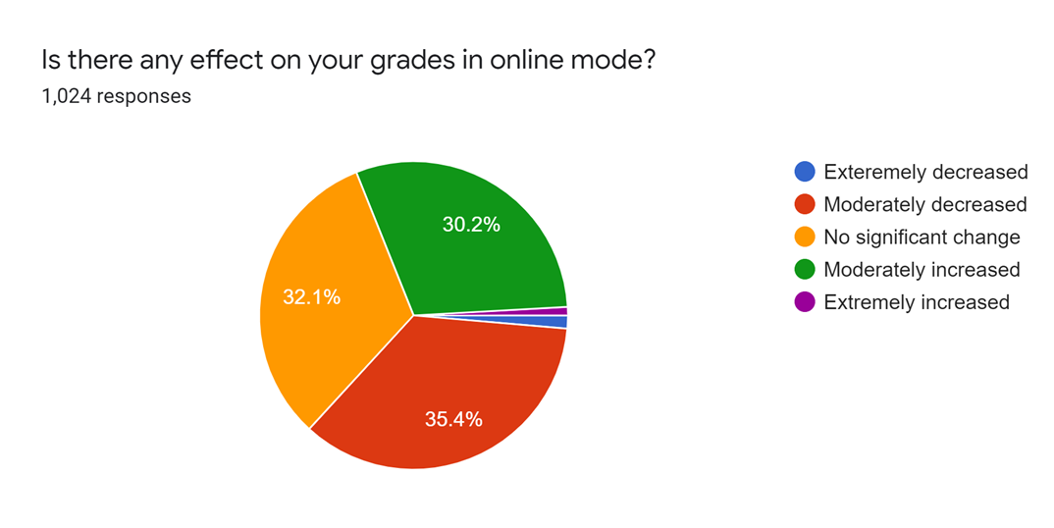

Slide 21
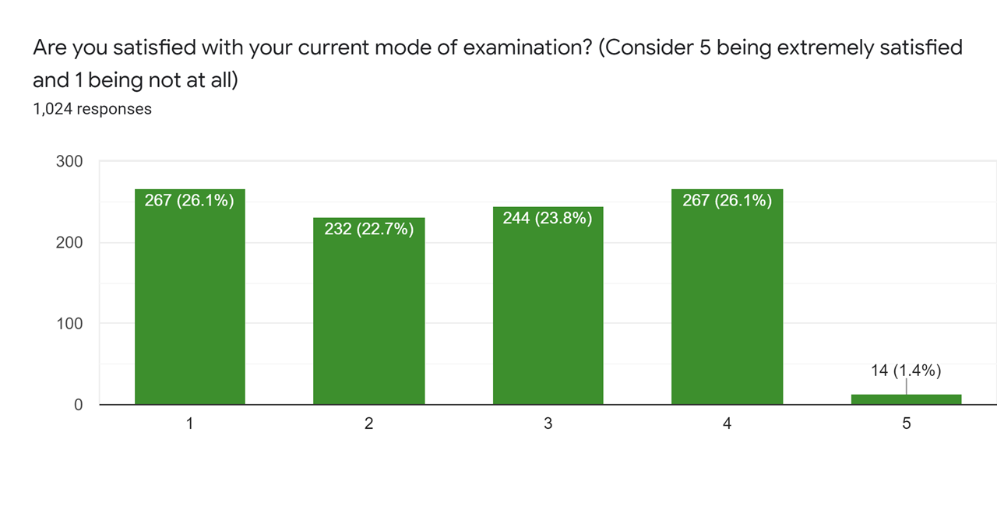

Slide 22
Main Message: -
The online examination takes less time as compared to the offline examination.
Susceptible to Cheating.
Sitting long hours in front of the system causes health issues

Slide 23
Employment Issues
The education sector is one of the largest systems in India and of course, the pandemic affect it a lot
All classes have changed their mode from offline to online and sadly it had effect employment ratio a lot be it workers who are fired Because of no work in schools for them or the transport service provider who had lost their job as there is no need.
Not only workers teachers but graduating students have also become a victim of this situation as many companies are not hiring new interns due to their bad financial condition

Slide 24
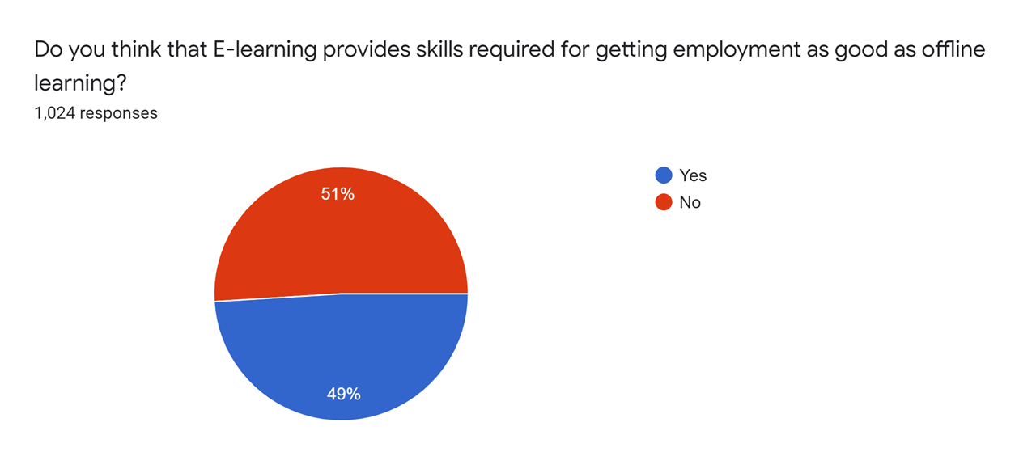

Slide 25
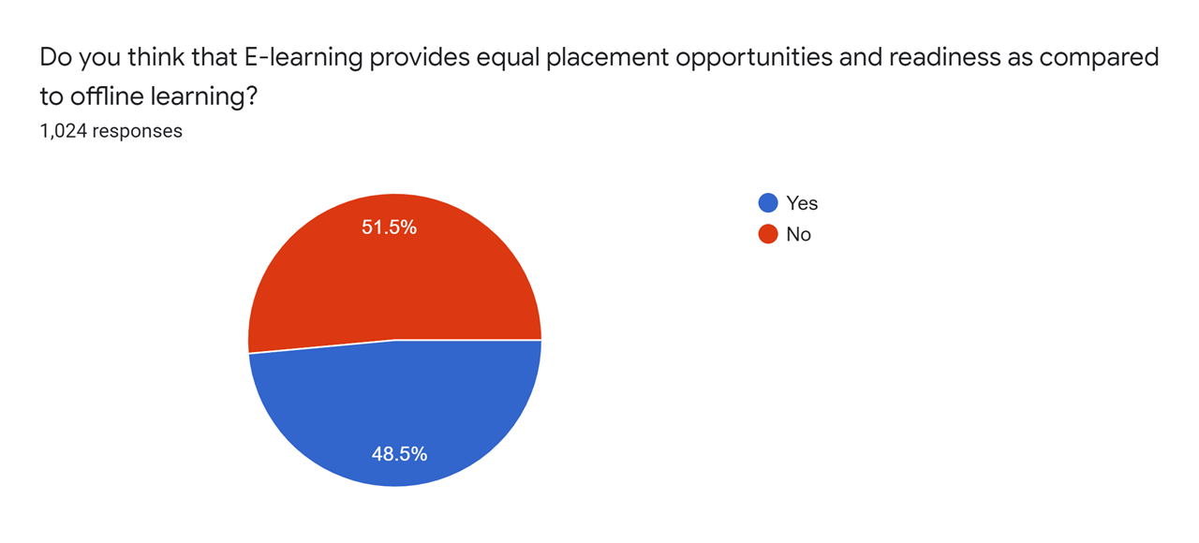

Slide 26
Main Message: -
Workers are losing their jobs.
Graduating students are facing problem in placements

Slide 27
Conclusion
Homeroom education is imperative to energize and spur synergistic learning. Study hall training improves understudies' basic reasoning abilities. Homeroom reading gives a chance to understudies to take part in live conversations where they can all the more likely use their basic intuition abilities to voice assessments or include in a contention.
Henceforth, traditional offline learning is positively a more compelling alternative. But at the same time, online education is the need of the hour due to the pandemic.

Slide 28
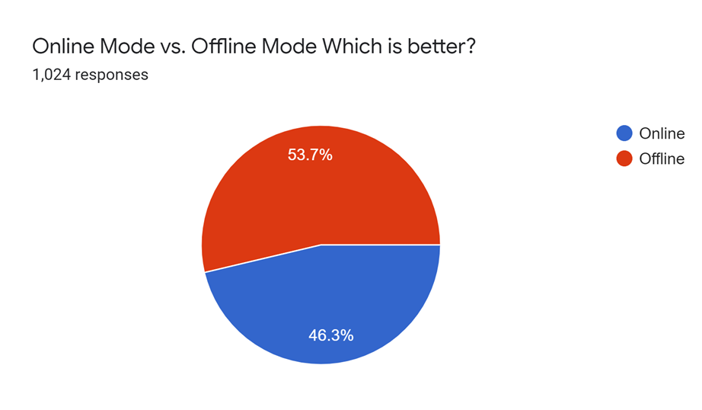

Slide 29
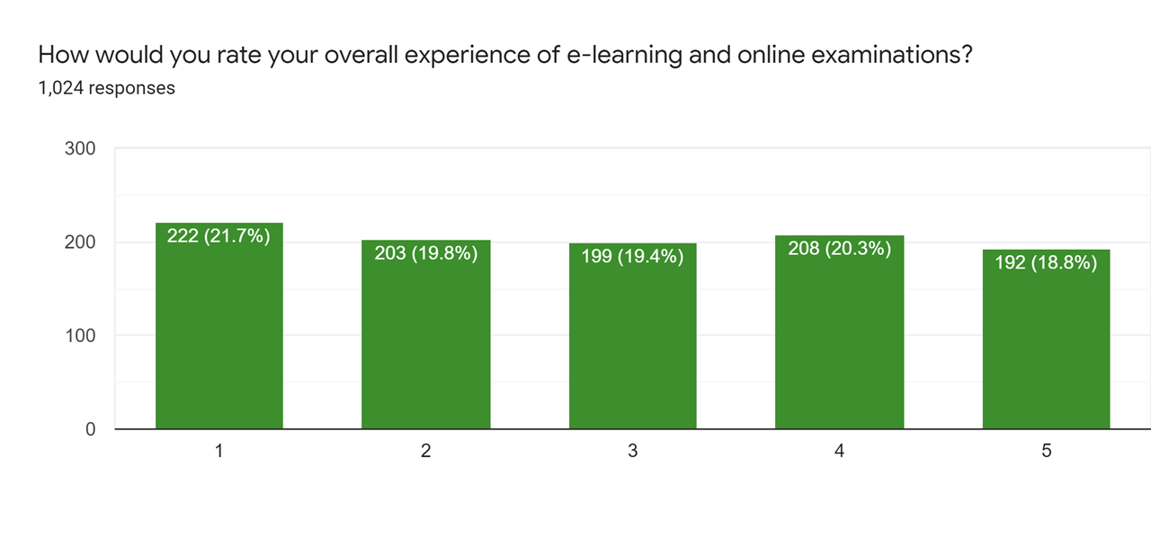

Slide 30
Main Message: -
Learners prefer the offline mode of learning.
The Online mode isn’t unworthy but requires few significant changes

Slide 31
Responses and Questionnaire
Link for the questionnaire:
https://forms.gle/XYCzKF6YuHPSaW5W9
Link for the responses sheet:
https://drive.google.com/file/d/1BhekVcCNkG_5QXwqpj2LNAqGMs5-1nA4/view?usp=sharing

